Slide 1
CastleRock™ Insulated Porcelain Siding & Cladding Products

Slide 2
The Challenge

Slide 3
What is the goal?

Slide 4
CastleRock™ Porcelain Wall Cladding

Slide 5
Installation Guides and Warranties

Slide 6
How it works!

Slide 7
Standard Sizes

Slide 10
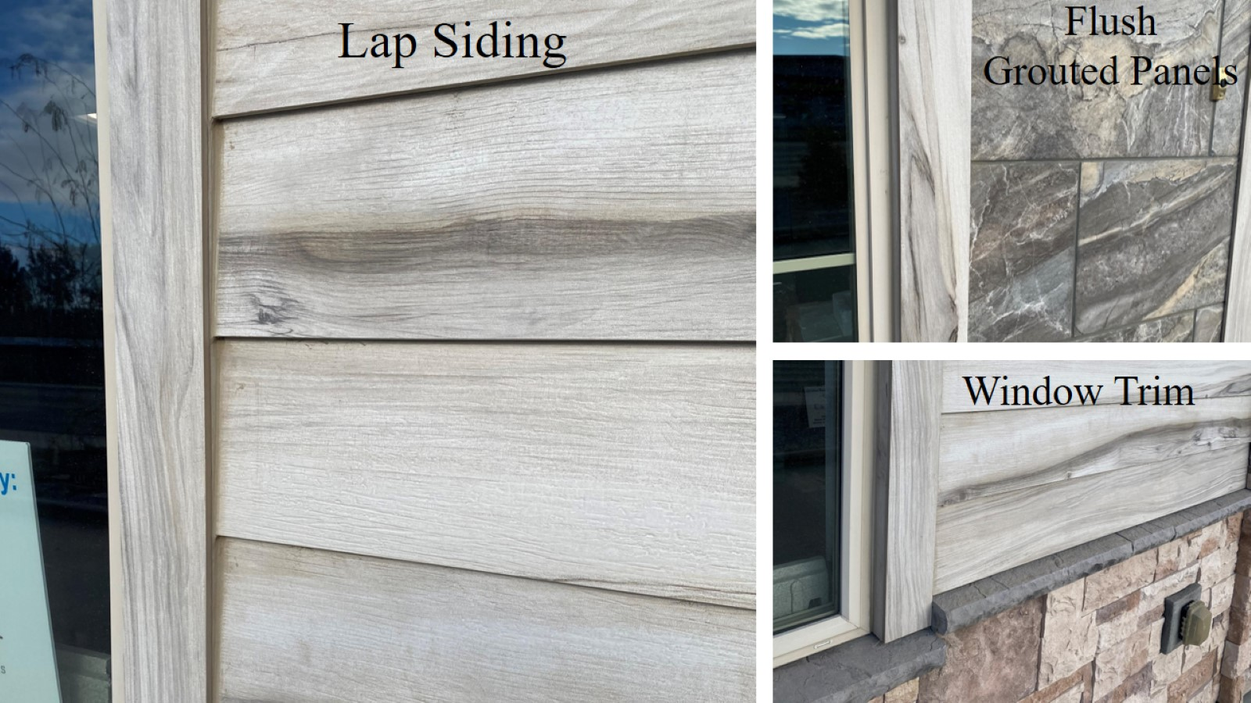

Slide 11
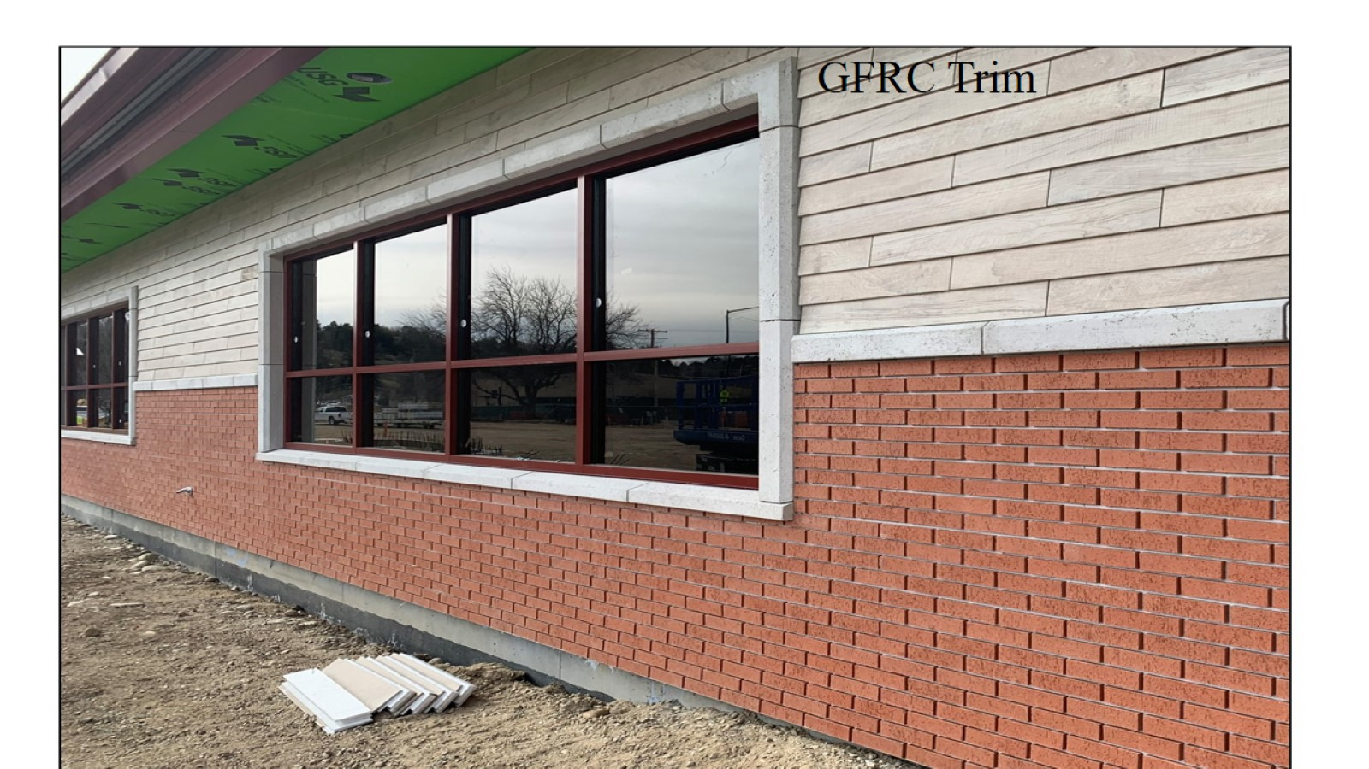

Slide 12
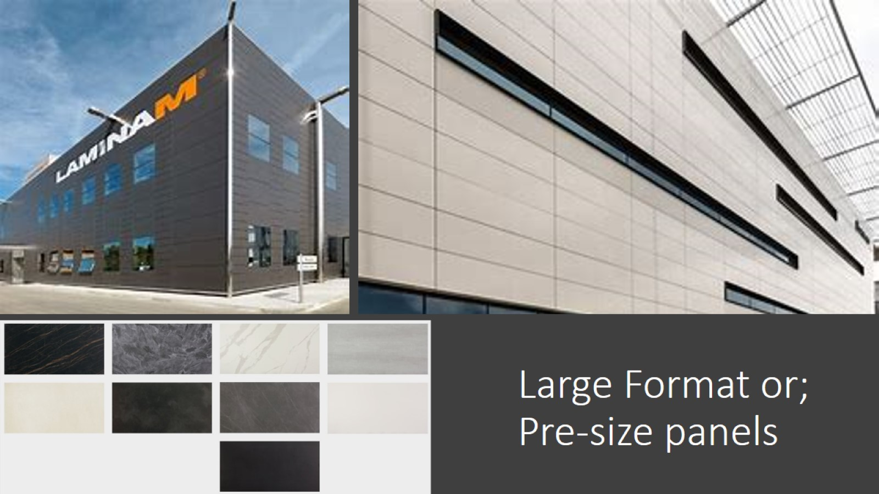
Large Format or; Pre-size panels

Slide 14
Porcelain Brick System

Slide 15
Porcelain Brick Flat Panels 4” x 12”

Slide 16
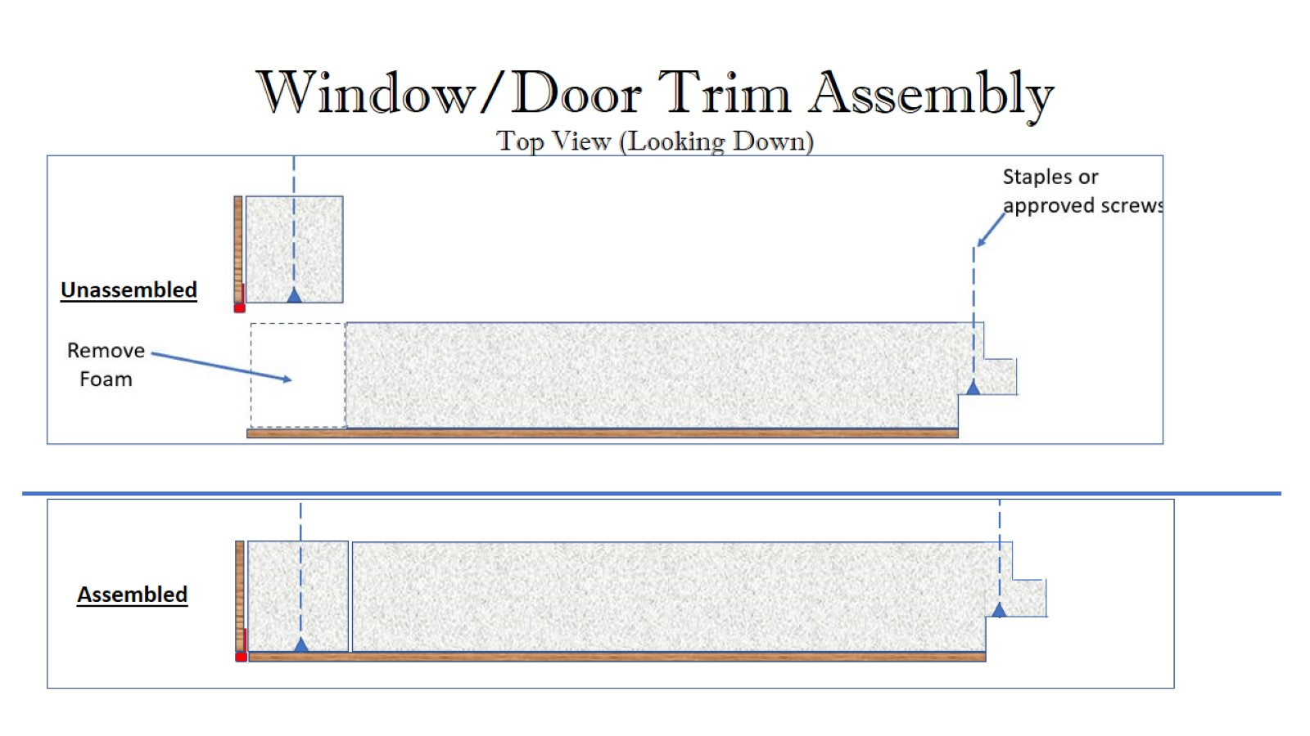
Window/Door Trim Assembly Top View (Looking Down)

Slide 17
Outside Corner Assembly Top View (Looking Down)

Slide 18
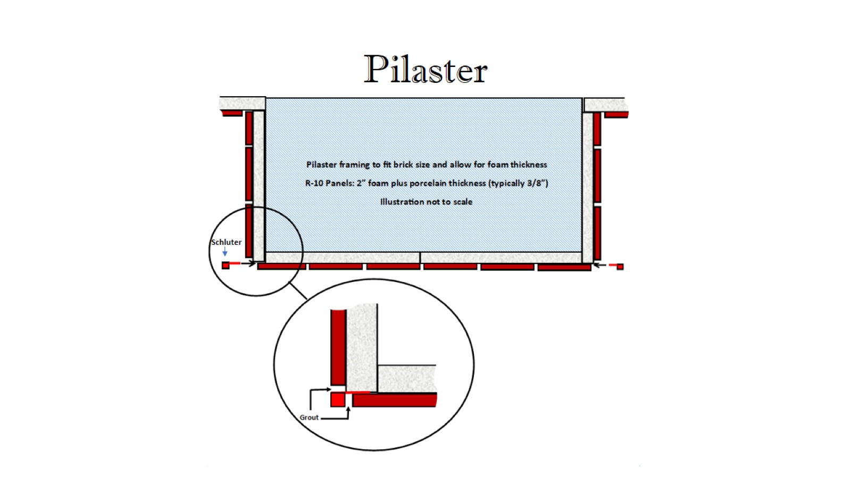
Pilaster

Slide 19
Window (Side View)

Slide 21
Squares, Rectangles & Large Format

Slide 22
Beauty & Aesthetics

Slide 24
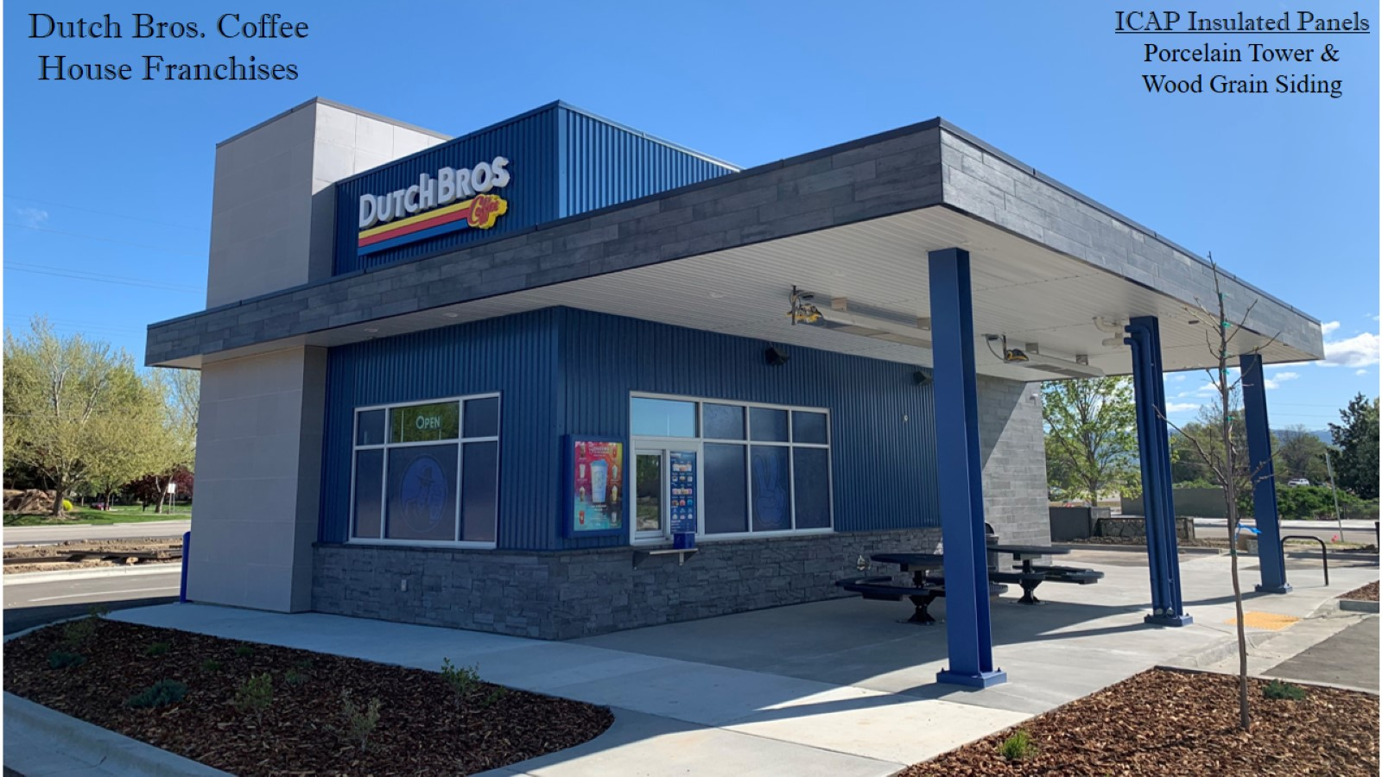

Slide 25
Porcelain Lap Siding Our fastest installing, least expensive System

Slide 26
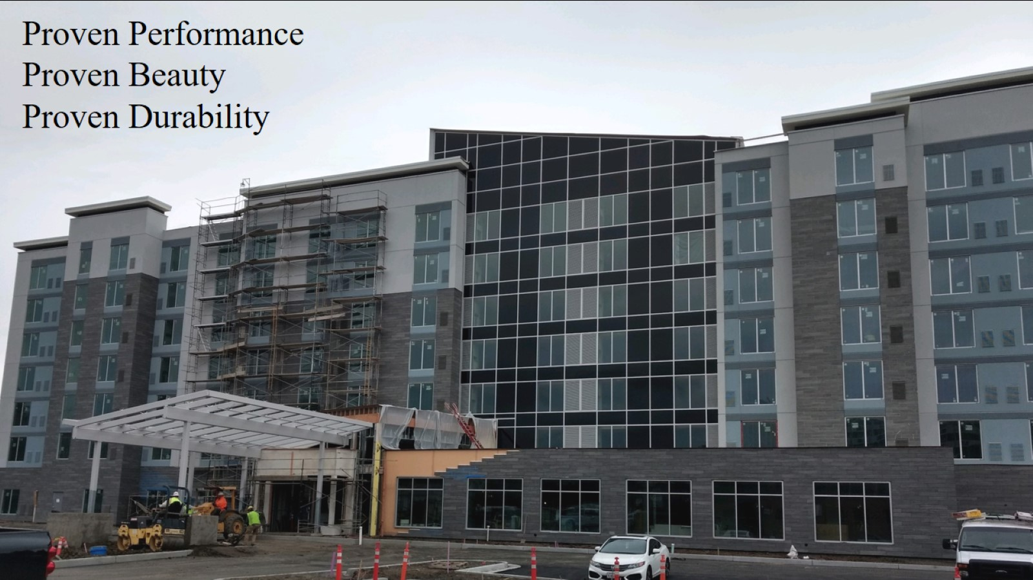

Slide 27
Fast, Easy Installation

Slide 28
- Interlocking panels - Install with staples or screws - Installs in any weather - Reduces labor time & cost - Reduces construction time - Damaged panel replaces without dismantling

Slide 29
Installing ICAP Claddings

Slide 30
Porcelain Installation

Slide 32
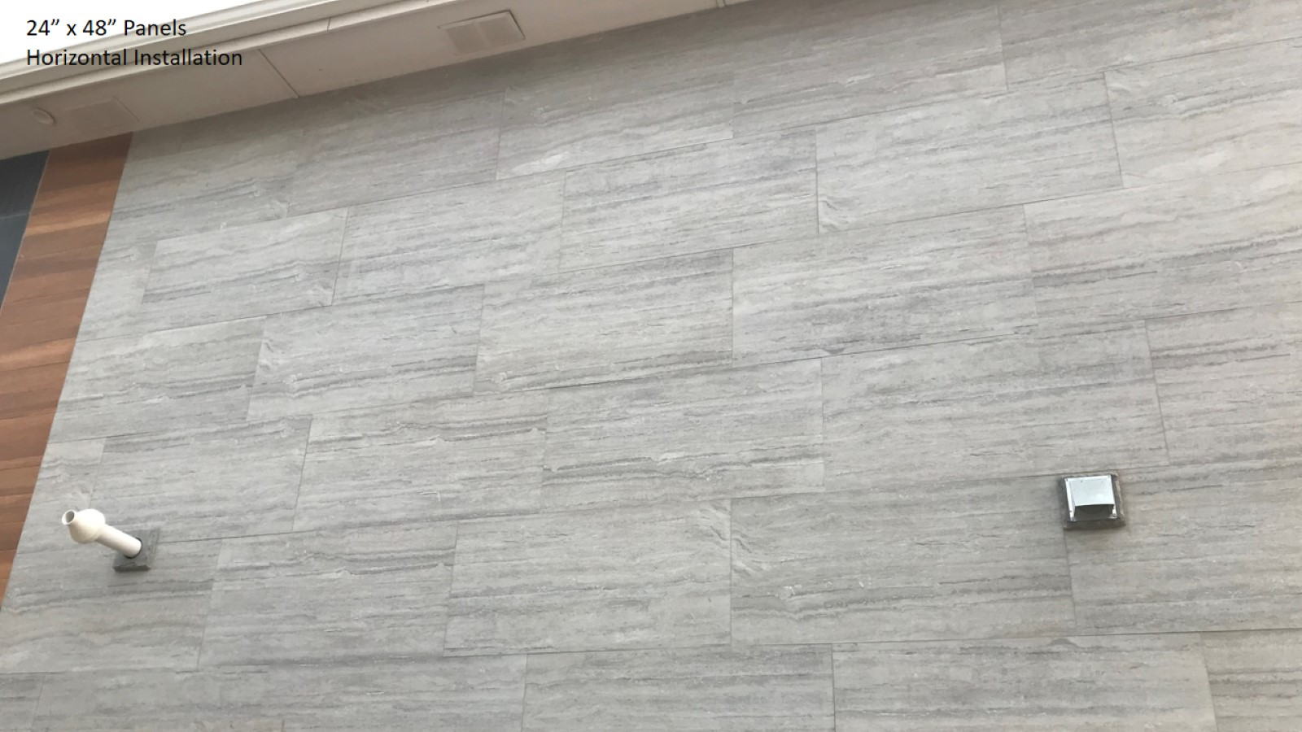

Slide 33
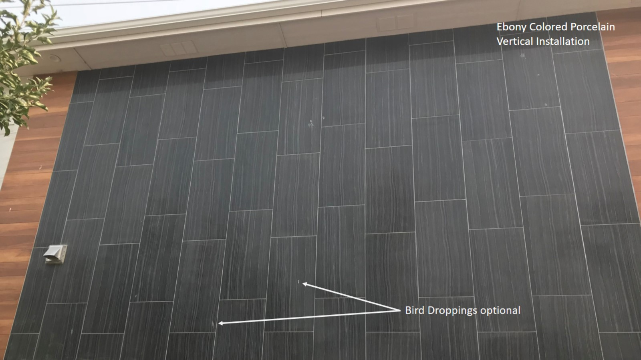

Slide 34
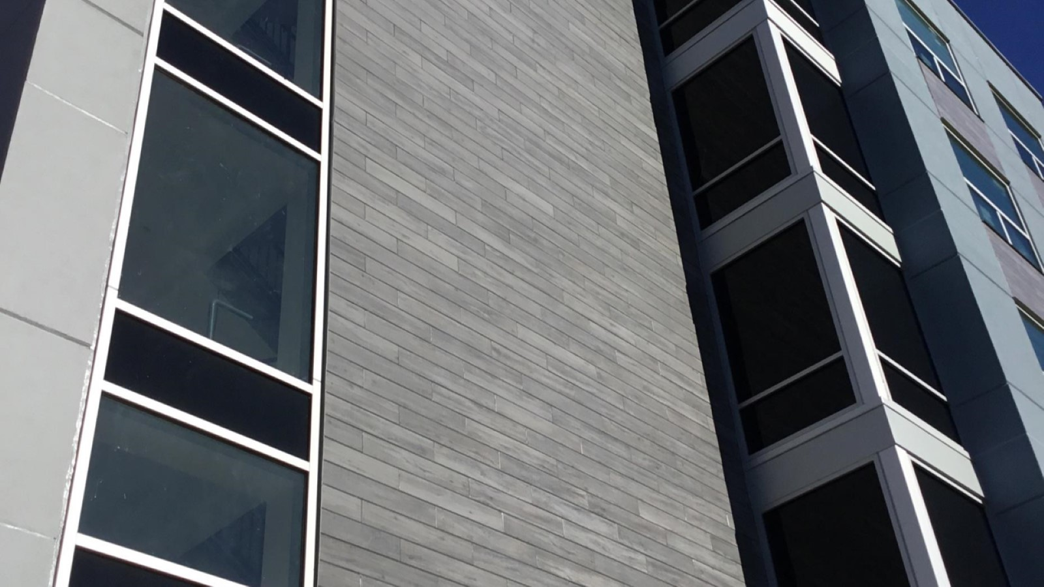

Slide 35
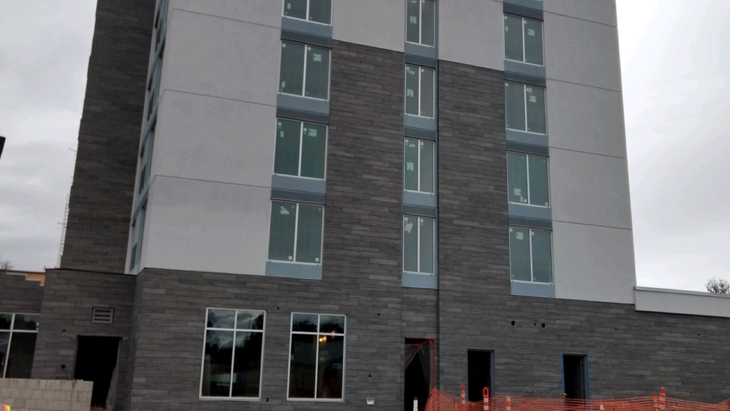

Slide 36
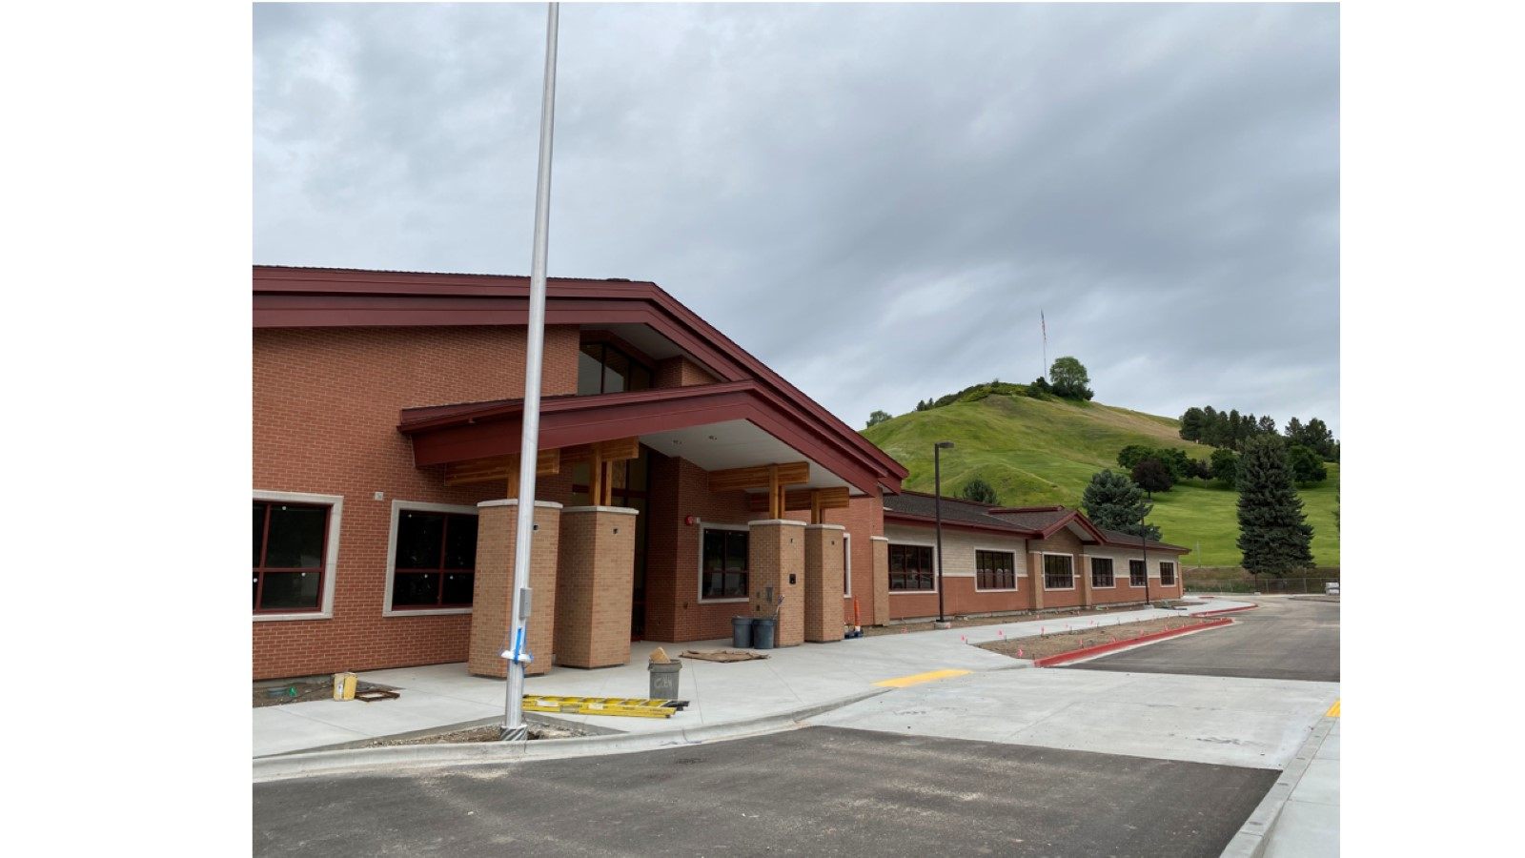

Slide 37
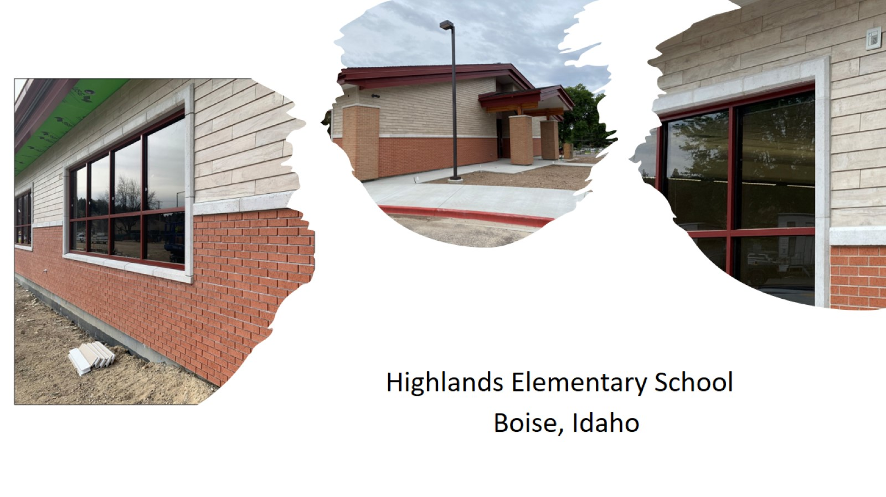

Slide 39
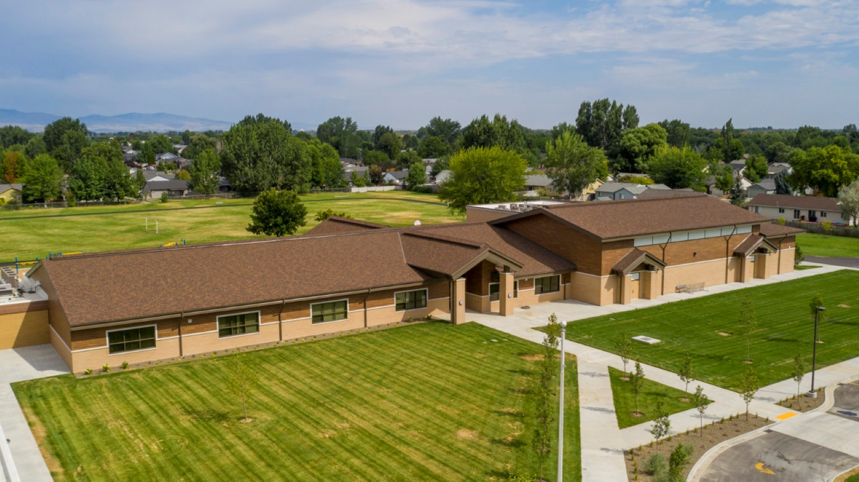

Slide 40
Reduce Labor Costs

Slide 41
Architectural Masonry Fascia

Slide 44
Questions?

Slide 45
www.castlerockx.com

